Slide 1
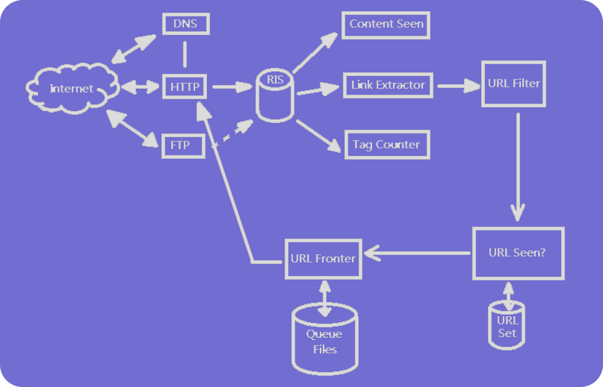
Python实现crawler

Slide 2
Docker+crawler→得到crawler-node
Docker-image
docker registries
docker registries
docker containers
Docker images
docker images

